Slide 1
Python Pandas Library
Tseng-Ching James Shen, Ph.D.

Slide 2
Agenda
Data Collection/Conversion
Exploratory Analysis & Cleanup
Pandas DataFrame Class
Case Study

Slide 3
Data Collection
Data are collected in OLTP database
OLTP data are normally normalized to minimize redundancy
Customer
Cust ID | First Name | Last Name | SC ID
1 | John | Chen | 2
2 | Frank | Sampson | 1
 | … | … | …
Shopping Cart
ID | Name
1 | Cart_1
2 | Cart_2
… | …
Foreign Key
Foreign Key
Order
ID | SC ID | Prod ID | Quantity
1 | 2 | 5 | 2
2 | 2 | 4 | 3
… | … | … | …

Slide 4
Dataset
Data to be analyzed is called a dataset which is in one 2-dimensional table format
Each row is one sample
Columns are features
Data sets are normally un-normalized to easily explore/understand the possible correlation among different features
First Name | Last Name | SC Name | Order ID | Prod ID | Quantity
John | Chen | Cart_2 | 1 | 5 | 2
John | Chen | Cart_2 | 2 | 4 | 3
 |  | …

Slide 5
Data Conversion
Convert OLTP data into data sets prior to analysis
Convert OLTP data into one dataset by performing a sequence of JOIN operations on OLTP data

Slide 6
Exploratory Analysis & Cleanup
Perform following types of analysis on datasets
Descriptive statistics
Investigate the data characteristics on a given feature
Correlation
Investigate how two features are correlated to each other
GroupBy and Aggregation
Partition data into groups with some features meet certain criteria
Study the data characteristics in one group or between groups
Handling missing data

Slide 7
Pandas DataFrame Class
DataFrame class encapsulates the implementation for the 2-dimensional structure of the dataset
Column labels
Column data
Row labels
Row data
Developers manage (e.g. create, access, modify, combine) datasets via various DataFrame properties, operators, and methods and Pandas functions

Slide 8
DataFrame Constructors
Row-based constructors
List object
Column-based constructors
Dict object

Slide 9
DataFrame Operators
Indexing operator
Access/update column(s)
One element indexing
Fancy indexing
Access/update row(s)
Mask indexing
Single condition: ==, !=, >=,> <=, <
Multiple condition: &, |
Slicing
Mathematical operators
+, -, /, *, %, //

Slide 10
DataFrame Properties
Access the content
Index
column
dtypes
Values
Column label property
Access certain rows and columns (sub-table) of a DataFrame object via the following properties
loc
iloc
Ix (depreciated)
Use properties to modify DataFrame
Update index/column
Update content

Slide 11
DataFrame Methods
File I/O methods
Mathematical methods
Iterator-based methods
Statistical methods
Aggregate/Grouping/Append method
Handling missing data

Slide 12
DataFrame - File I/O Methods -
Persist/Read DataFrame object in/from a CSV file
to_csv()
read_csv()
Persist/Read DataFrame object in/from a JSON file
to_json()
read_json()
SQL table
to_sql()

Slide 13
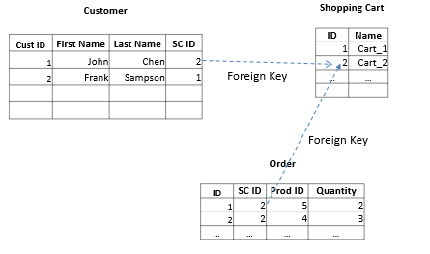
Case Study I - Python Data Persistence -
Use Pandas DataFrame to persist OLTP eCommerce data

Slide 14
Functionalities
Create an object & its related objects
Covert Python object into DataFrame record
Write the DataFrame to a file
Modify an object & its related objects
Use Pandas Input method to build the DataFrame object
Find the DataFrame record with unique object id
Modify the record
Write the DataFrame back to a file
Delete an object & its related objects
Query an object & its related objects

Slide 15
DataFrame - Iterator-based Methods -
Item-by-item iteration
iteritems()
Row-by-row iteration
iterrows()
itertuples()

Slide 16
DataFrame - Mathematical Methods -
Cell-based methods
add(), sub(), mul()
truediv(), div(), floordiv(), mod()
pow()
applymap()
Column-based (or row-based) methods
apply()

Slide 17
DataFrame - Statistical Methods -
Single-column (or single-row) methods
count()
sum()
mean(), median()
std()
min(), max()
Two-column methods
cov()
corr()

Slide 18
DataFrame - Aggregate/Grouping/Append Methods -
aggregate()
groupby()
append()

Slide 19
Case Study II - Exploratory Analysis -
2018-2019 NBA players’ statistics
Types of analysis
Descriptive statistics
Correlation analysis
Groupby and aggregate
https://www.nbastuffer.com/2018-2019-nba-player-stats/

Slide 20
Pandas Functions
concat()
merge()
A
B
A
B

Slide 21
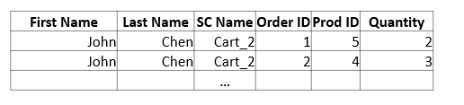
Case Study III - Python Data Conversion -
Use DataFrame API to un-normalize the data

